Slide 1
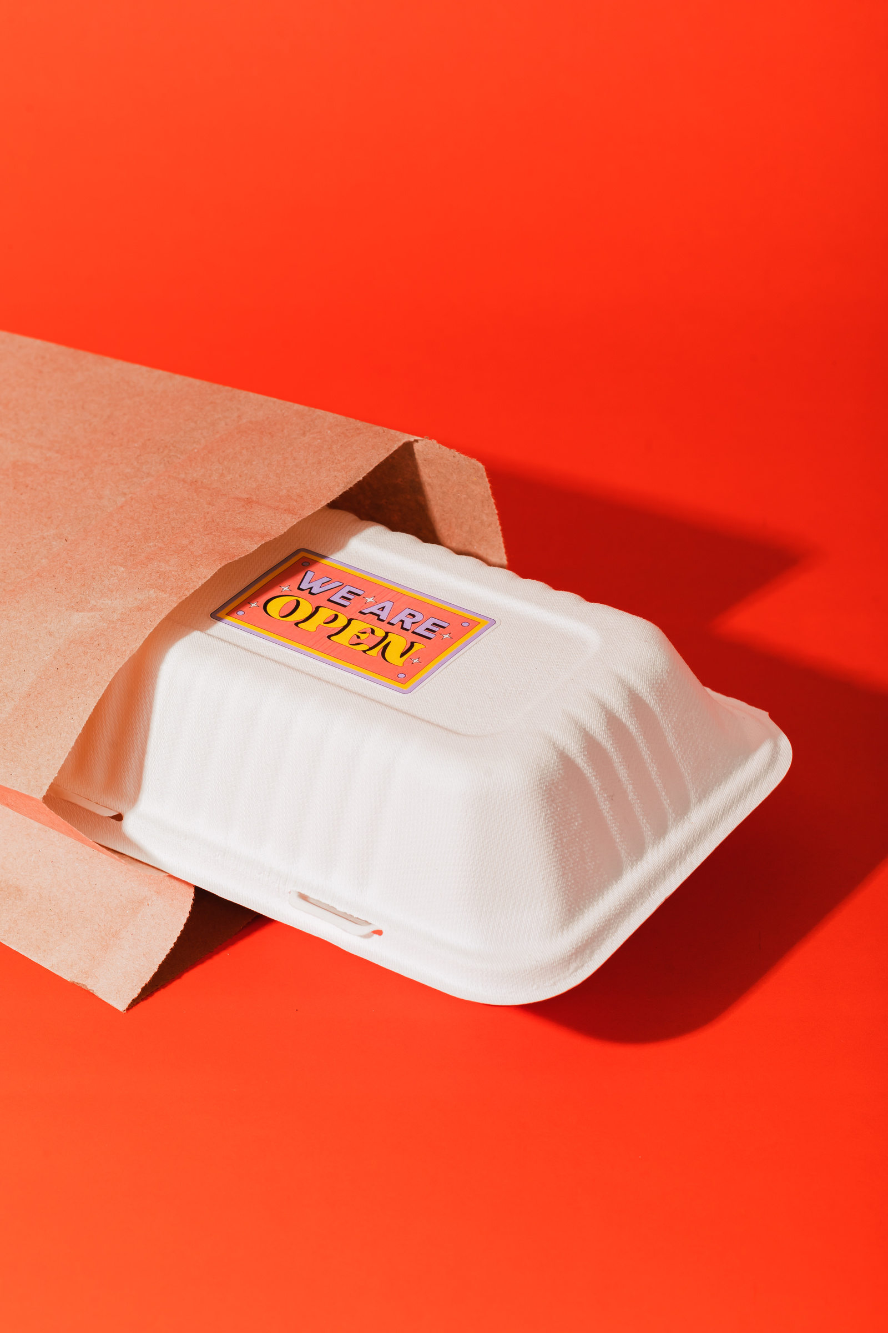


Indian Kitchen
Admin
Manager
Cashier
FAST FOOD
BILLING SYSTEM
AP22110011145 AP22110011152
AP22110011151 AP22110011161
01

Slide 2
INDIAN KITCHEN
Cashier
Admin
Manager
TECH STACK USED
Frontend
Backend
CLIENT SIDE
SERVER SIDE
REACT JS
TYPESCRIPT
TAILWIND CSS
VITE JS
SUPABASE
POSTGRE SQL
02

Slide 3
INDIAN KITCHEN
Cashier
Admin
Manager
ADDITIONAL
TOOLS
Build Tools
Tools/Libraries
POST CSS
ES LINT
Bun Runtime
Shadcn/ui
Vite
pnpm/npm
CLIENT SIDE
02

Slide 4
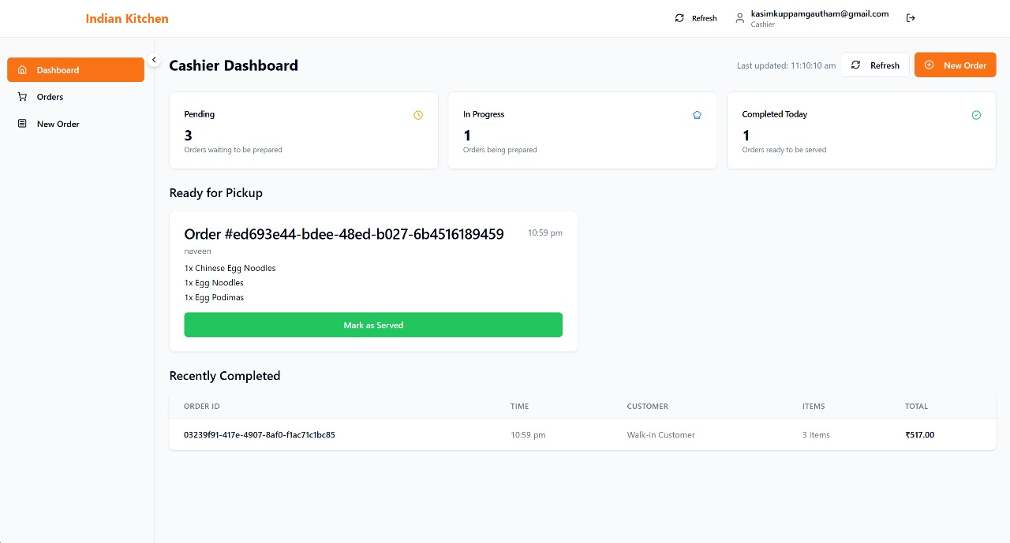
INDIAN KITCHEN
Cashier
Admin
Manager
03

Slide 5
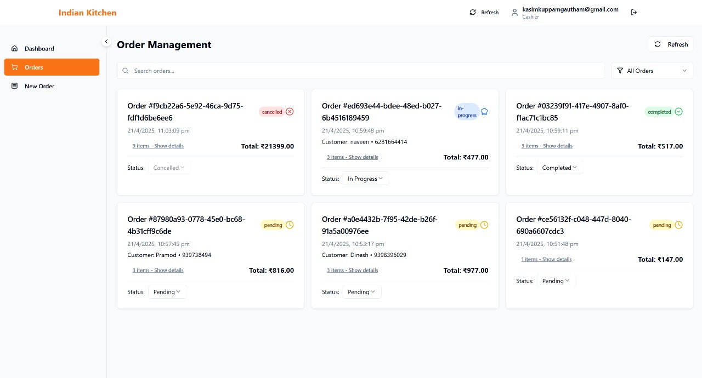
INDIAN KITCHEN
Cashier
Admin
Manager
03

Slide 6
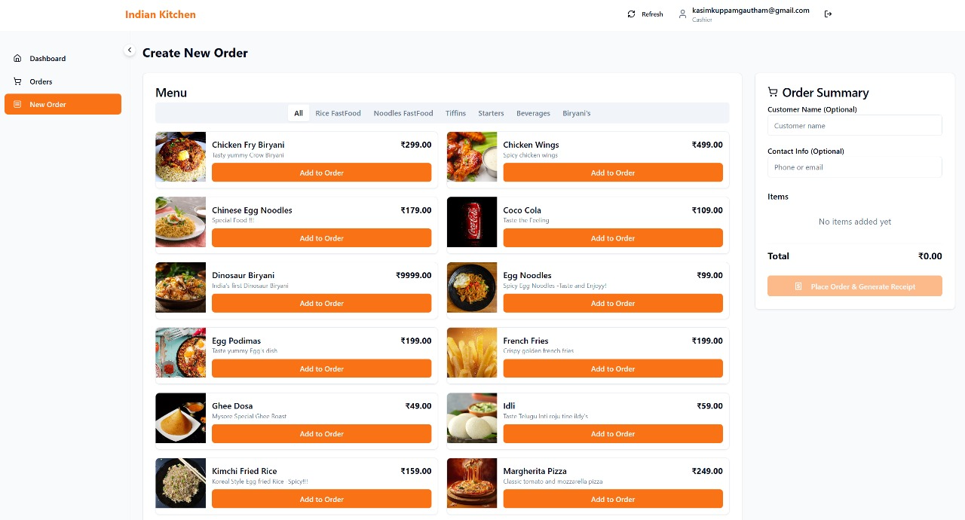
INDIAN KITCHEN
Cashier
Admin
Manager
03

Slide 7
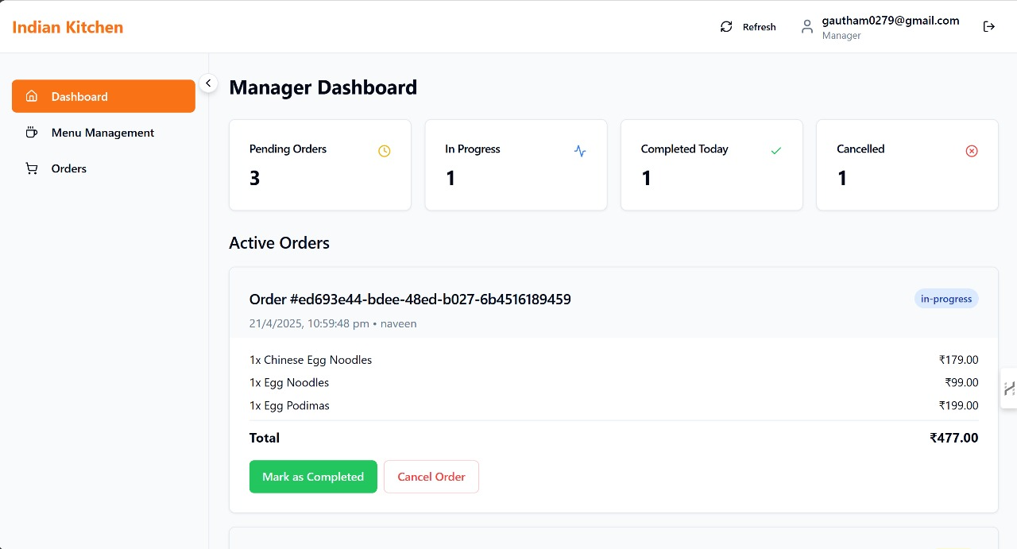
INDIAN KITCHEN
Cashier
Admin
Manager
03

Slide 8
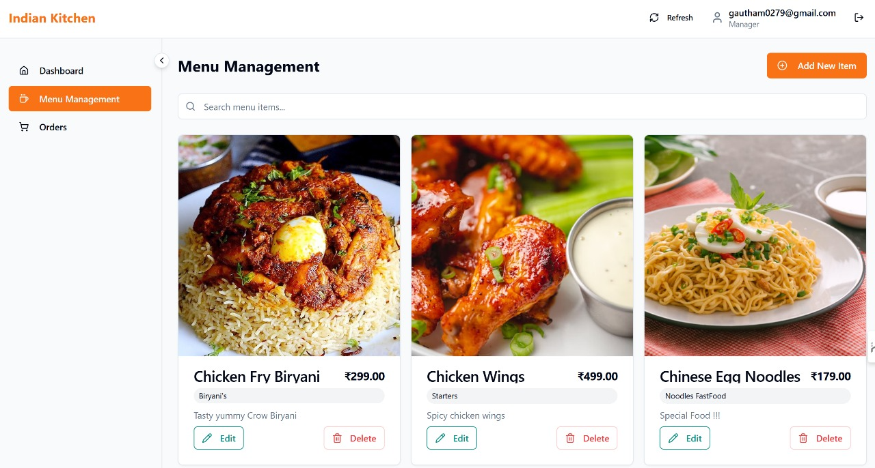
INDIAN KITCHEN
Cashier
Admin
Manager
03

Slide 9
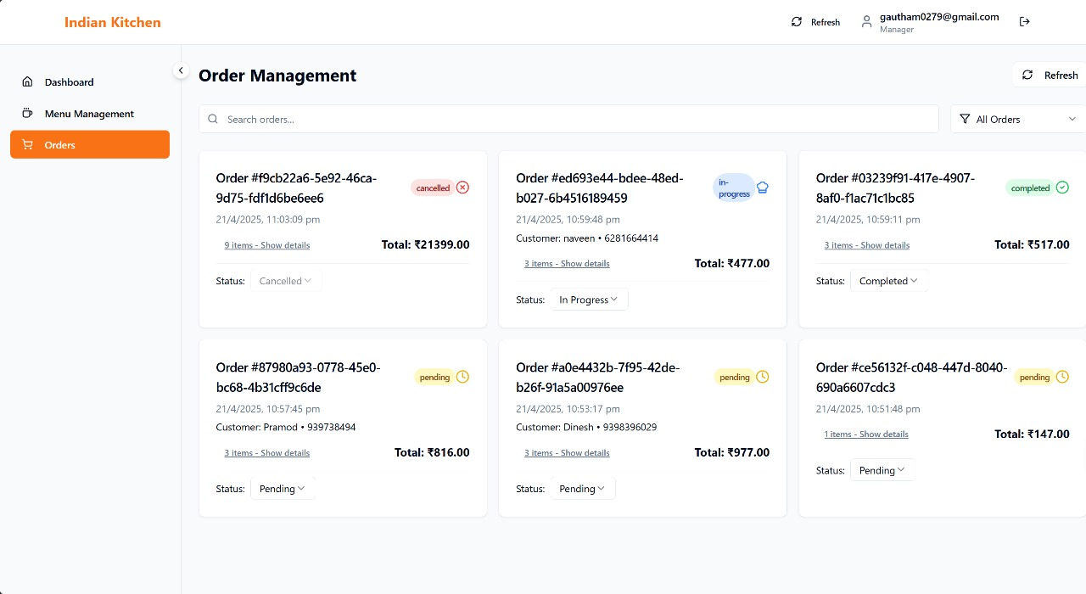
INDIAN KITCHEN
Cashier
Admin
Manager
03

Slide 10
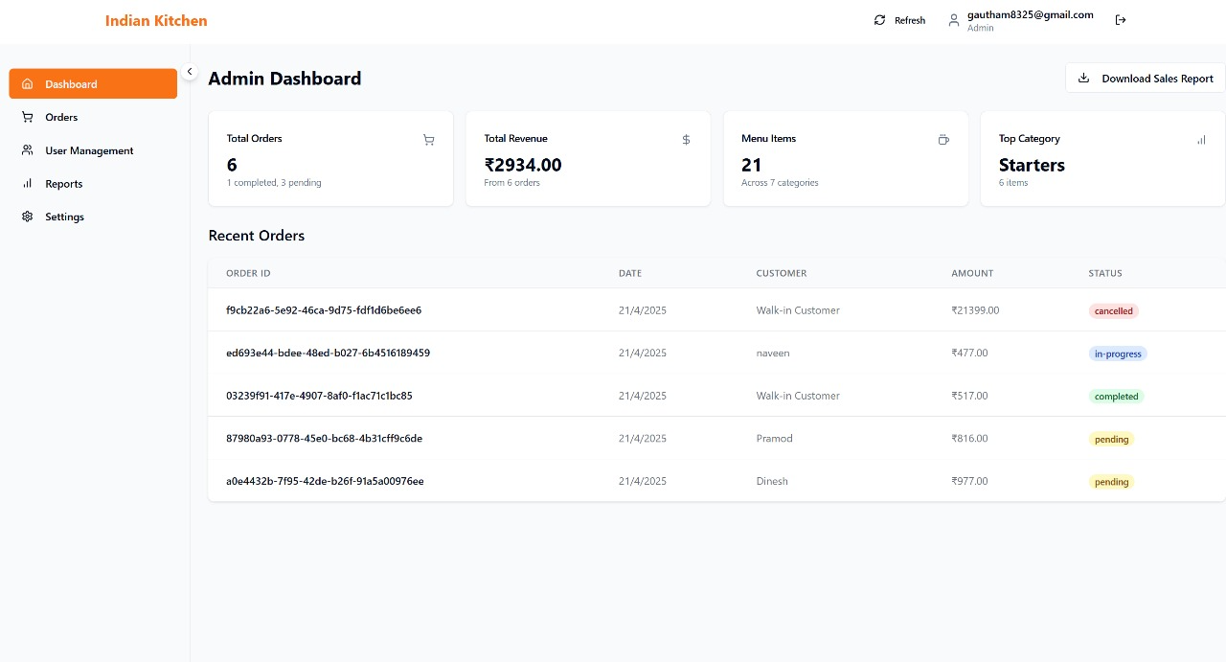
INDIAN KITCHEN
Cashier
Admin
Manager
03

Slide 11
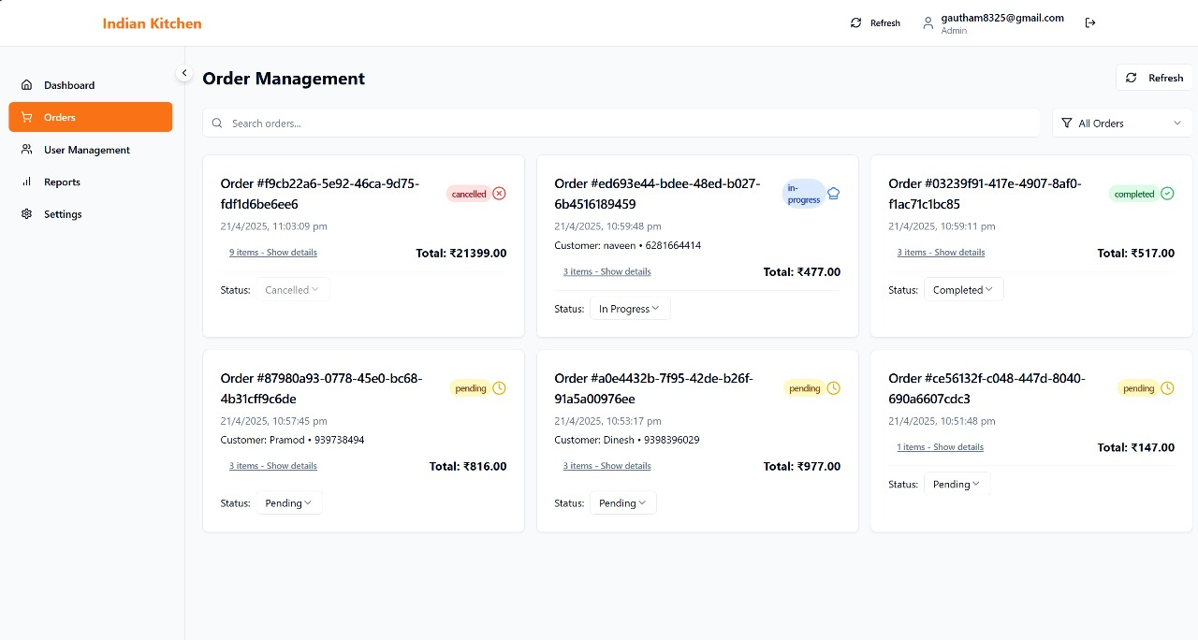
INDIAN KITCHEN
Cashier
Admin
Manager
03

Slide 12
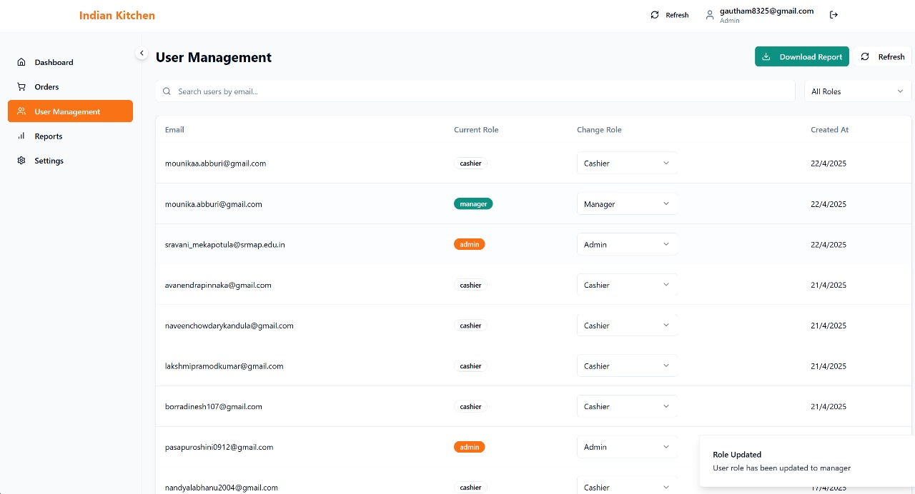
INDIAN KITCHEN
Cashier
Admin
Manager
03

Slide 13
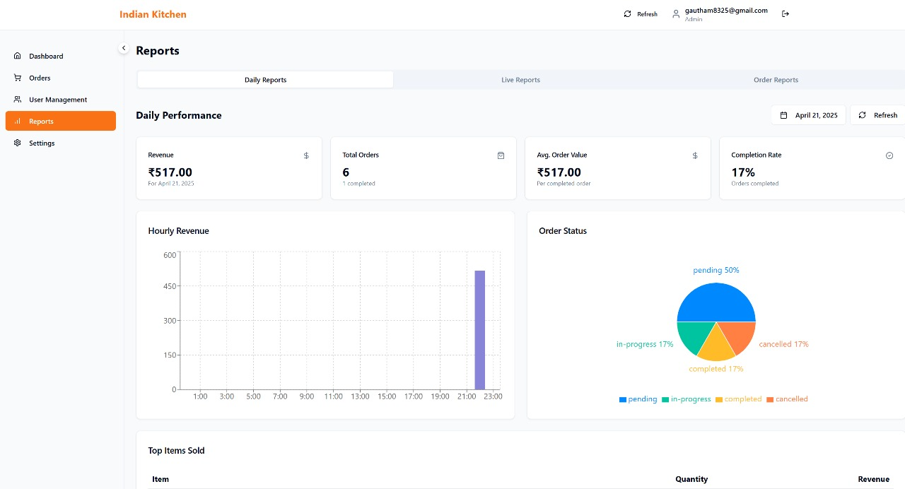
INDIAN KITCHEN
Cashier
Admin
Manager
03

Slide 14
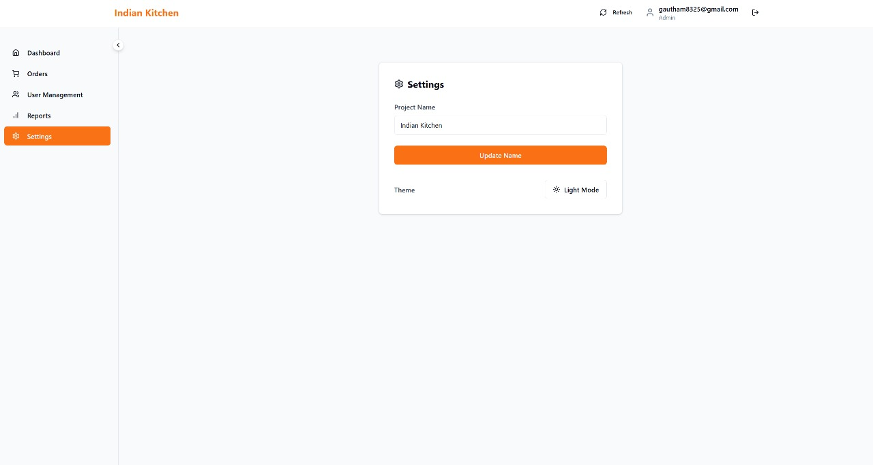
INDIAN KITCHEN
Cashier
Admin
Manager
03

Slide 15
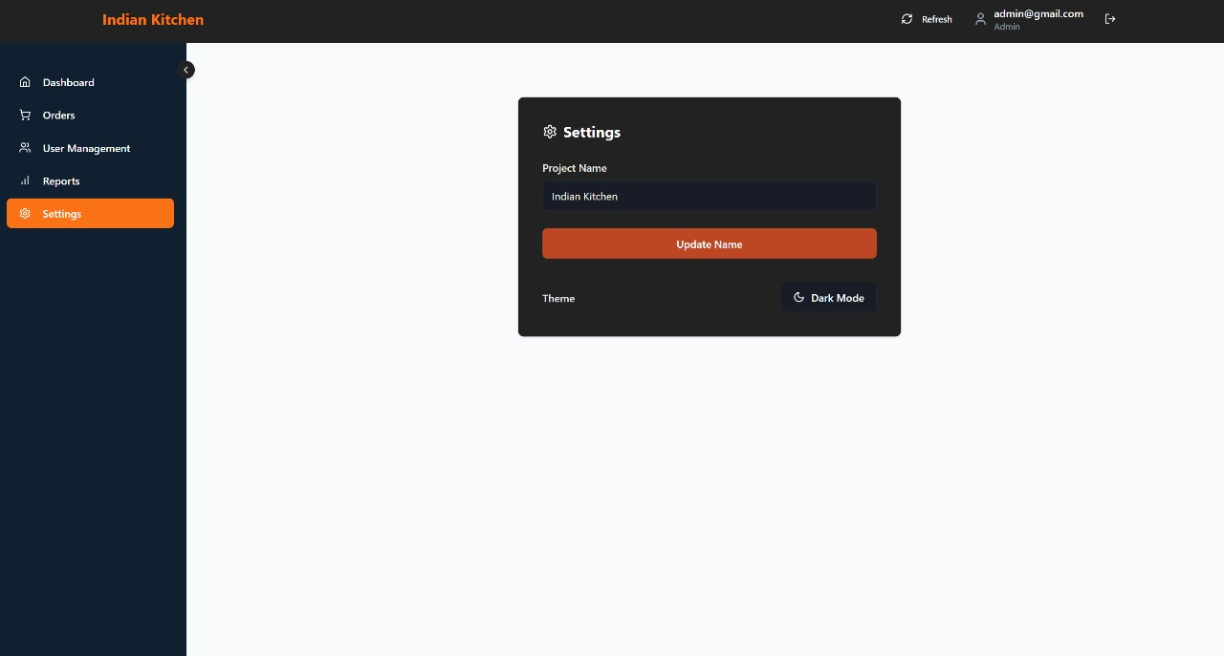
INDIAN KITCHEN
Cashier
Admin
Manager
03

Slide 16
INDIAN KITCHEN
Cashier
Admin
Manager
WEBSITE
LINK
CLICK HERE

Slide 17


INDIAN KITCHEN
SecurityFeatures
Supabase Authentication (Future Scope)
Add secure user login & signup functionality.
Encrypted Passwords (Supabase Default)
Even admins cannot view user passwords — Supabase stores passwords securely using encryption, ensuring privacy.
Environment Variables
API keys and credentials are kept safe in .env files (never exposed in code).
Role-Based Access (Optional)
Control what data users vs admins can access.
Input Validation (Planned)
Prevent malicious data with input checks and sanitization.
Secure Deployment (HTTPS)
Hosted on Vercel, which ensures a secure, encrypted HTTPS connection.
04

Slide 18
INDIAN KITCHEN
Cashier
Admin
Manager
Future Enhancements
Recipe Submission System
Enable users to contribute their own Indian recipes to the platform.
Admin Dashboard
Admin panel to manage submitted recipes, users, and site content.
Dark Mode Support
Enhance user experience with a light/dark theme toggle.
Progressive Web App (PWA)
Installable on phones and usable offline like a native app.
Multi-language Support
Translate the app for wider accessibility across different Indian languages.
05

Slide 19

INDIAN KITCHEN
Cashier
Admin
Manager
Thank
You!
TEAM INDIAN KITCHEN
10

